Slide 1
Customer Meeting
SE03

Slide 2
Agenda
Original goals of iteration
Our progress
Missed objectives
Issues we've had
Change in technology stack
Goals for next iteration and risk
Final questions

Slide 3
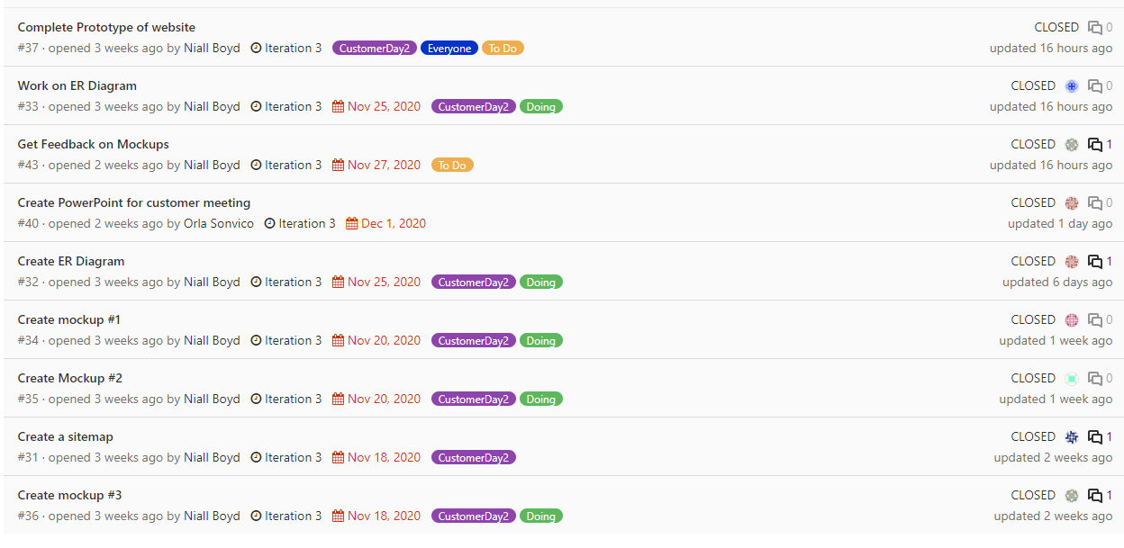
Original Goals for Iteration 3 (Nov 11-Dec 2)
Create Sitemap
Create ER Diagram
Develop Wireframes (proposing different options)
Data flow diagrams
Initialize backend/client projects
Research initial test coverage
Sort out IP agreement

Slide 4
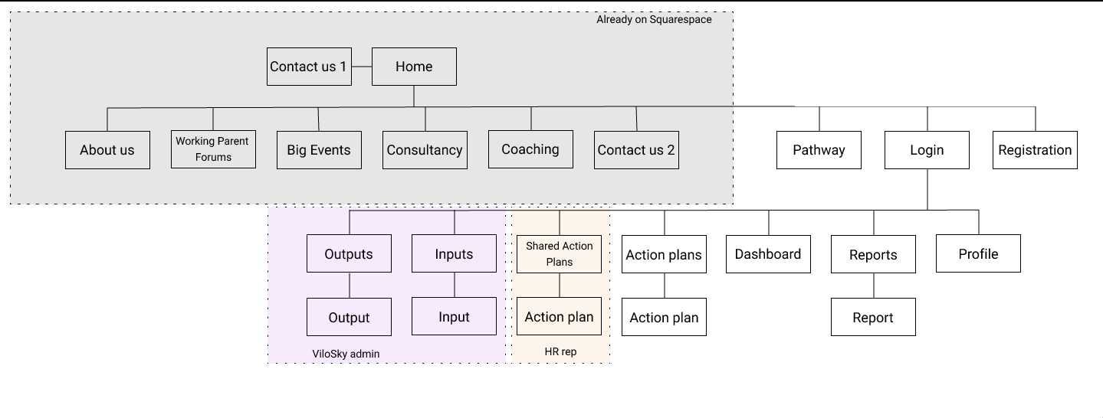
Our progress
Sitemap

Slide 5
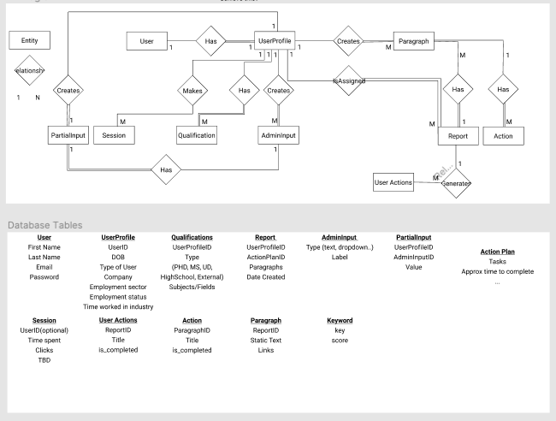
Our progress
Sitemap
ER Diagram

Slide 6
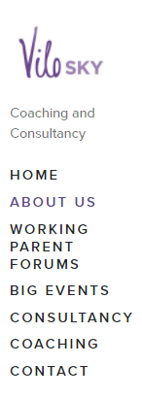
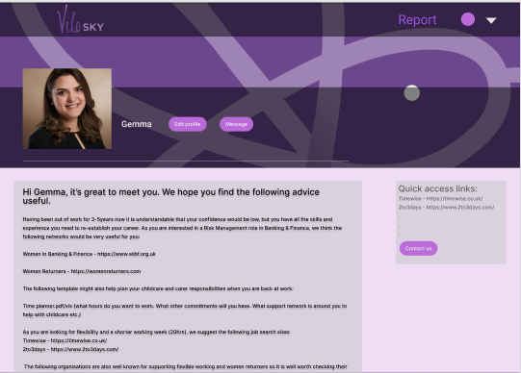
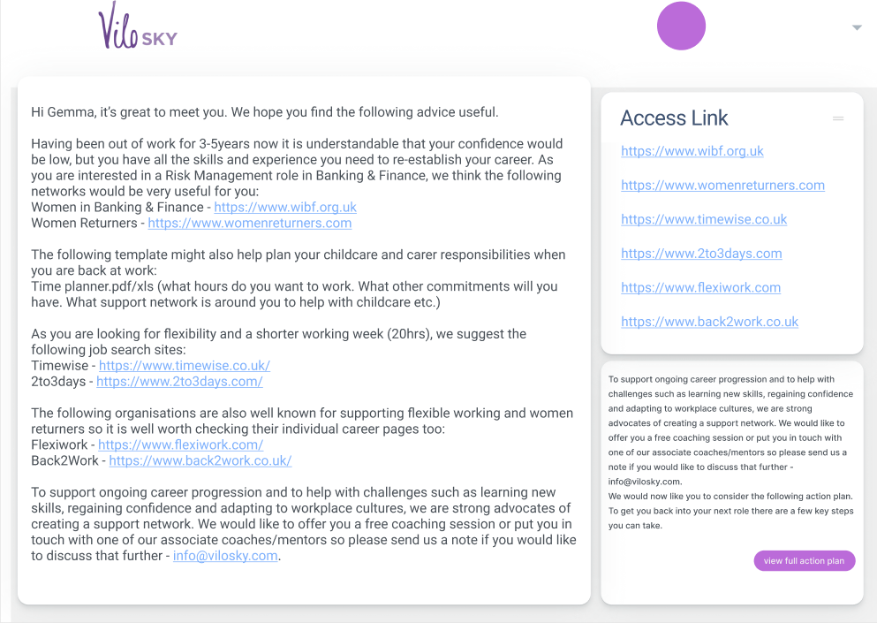
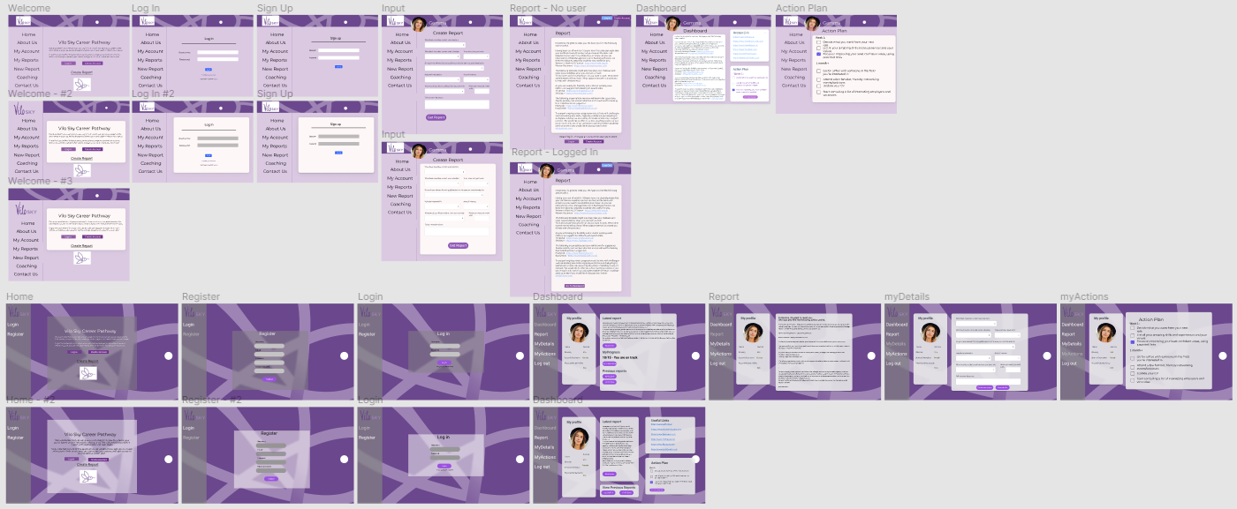
Our progress
Sitemap
ER Diagram
Wireframes

Slide 7
Our progress
Sitemap
ER Diagram
Wireframes
Initialize backend projects
Research initial test coverage

Slide 8
Wireframe Demonstration

Slide 9
Missed Objectives
Data Flow Diagram – unnecessary
Research Initial Test Coverage
IP Agreement

Slide 10
Issues
Better to email or have a short meeting?
ER Diagram was more complex than we initially thought

Slide 11
Technology Stack Change
Originally planned to use React for front end: more extendable for future development and more professional standard but higher risk
Not many of us have worked with it before, and there's a time limit
Considering using JavaScript/HTML/CSS instead, we've all used it before but could be difficult to extend in future

Slide 12
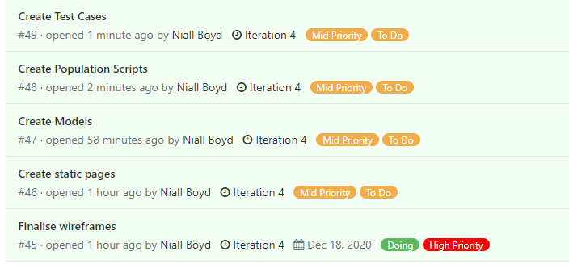
Next iteration goals & Risk
Finish wireframes for whichever option we've agreed on/has been approved by Louise & Vicky
Create static HTML/CSS pages
Create Models
Create Population Script
Research initial test coverage

Slide 13
Questions
Could you think about what data you would like to collect from users?

